Slide 1
Functions & Scoping
Department of Computer Science and Engineering
Chitkara University, Punjab

Slide 2
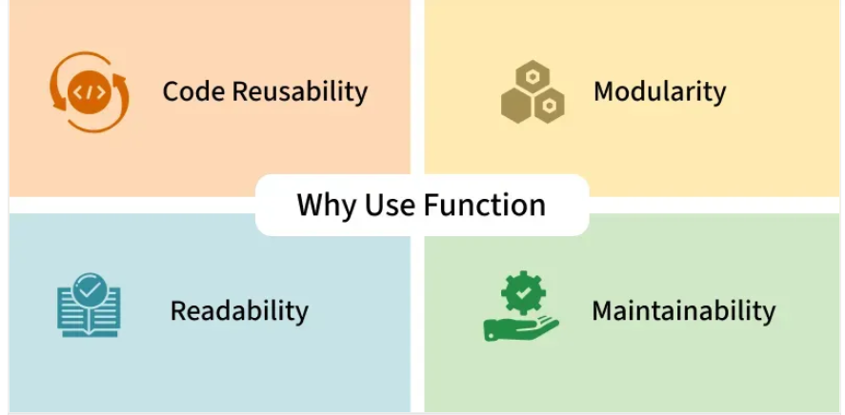
Functions in JavaScript
Functions in JavaScript are reusable blocks of code designed to perform specific tasks. They allow you to organize, reuse, and modularize code. It can take inputs, perform actions, and return outputs.

Slide 3
Function syntax
function functionName(parameters)
{
// code to be executed
}

Slide 4
<!DOCTYPE html>
<html>
<body>
<h2>JavaScript Function Example</h2>
<button onclick="showMessage()">Click Me</button>
<script>
function showMessage() {
alert("Hello! This is a JavaScript function.");
}
</script>
</body>
</html>

Slide 5
Various Declaration techniques in Jscript
1. Function Declaration with Parameters
<!DOCTYPE html>
<html>
<body>
<h2>Function Declaration Example</h2>
<script>
function greet() {
document.write("Hello!hello.");
}
greet(); // function call
</script>
</body>
</html>

Slide 6
Various Declaration techniques in Jscript
2. Variable Declaration
A variable within a function can be declared in the following ways:
Var
Let
Eg:
Var a =20;
Var a =30; // re-declaring via var variable is allowed
Let a = 10;
Let a = 20; // Cannot be redeclared in same scope
Const a = 3.15;
Const a = 14.5; // can’t be re-declared

Slide 7
Various Declaration techniques in Jscript
3. Function Declaration
Syntax:
{
function greet() {
document.write("Hello!");
}
______________________________________________________
<!DOCTYPE html>
<html>
<body>
<h2>Function Declaration Example</h2>
<p id="demo"></p>
<script>
function greet() {
document.getElementById("demo").innerHTML = "Hello, welcome to the example of function declaration.";
}
greet(); // function call
</script>
</body>
</html>

Slide 8
Various Declaration techniques in Jscript
4. Function Expression
Syntax:
let sayHi = function()
{
document.write("Hi!");
};
____________________________________________________
<!DOCTYPE html>
<html>
<body>
<h2>Function Expression Example</h2>
<p id="demo"></p>
<script>
let greet = function() {
document.getElementById("demo").innerHTML = "Hello, presenting you a generic Function Expression! Pls note there there is a semi-colon at the end of the function closure curly bracket.";
};
greet(); // function call
</script>
</body>
</html>

Slide 9
Various Declaration techniques in Jscript
5. Function declaration using Arrow (ES6)
Syntax:
const add = (a, b) => a+b;
____________________________________________________
<!DOCTYPE html>
<html>
<body>
<button onclick="show()">Click Me</button>
<script>
const show = () =>
{
alert("Arrow Function Clicked!");
};
</script>
</body>
</html>

Slide 10
Various Declaration techniques in Jscript
6. Class declaration
Syntax:
class Student {
constructor(name) {
this.name = name; }
}
</html>

Slide 11
<!DOCTYPE html>
<html>
<body>
<h2>Class Declaration Example</h2>
<button onclick="show()">Click</button>
<script>
class Person {
constructor(name) {
this.name = name;
}
greet() {
alert("Hello " + this.name);
}
}
function show() {
let p1 = new Person("Student");
p1.greet();
}
</script>
</body>
</html>

Slide 12
Understanding Functions
In functions, parameters are placeholders defined in the function, while arguments are the actual values you pass when calling the function
Example:
function greet(name) { // 'name' is a parameter
console.log("Hello " + name);
}
greet("Alice"); // "Alice" is the argument
Parameter → name (placeholder inside the function).
Argument → "Alice" (real value given at call time).

Slide 13
<!DOCTYPE html>
<html>
<head>
<title>Parameters and Arguments Example</title>
</head>
<body>
<h2>JavaScript Function: Parameters and Arguments</h2>
<button onclick="callGreet()">Click to Greet</button>
<script>
// Function definition
function greet(name) { // name → parameter
console.log("Hello " + name);
document.write("Hello " + name + "<br>");
}
// Function call
function callGreet() {
greet("Alice"); // "Alice" → argument
greet("Abhishek"); // another argument
}
</script>
</body>
</html>

Slide 14
JavaScript Function Expression
The Javascript Function Expression is used to define a function inside any expression. The Function Expression allows us to create an anonymous function that doesn’t have any function name which is the main difference between Function Expression and Function Declaration.
A function expression can be used as an IIFE (Immediately Invoked Function Expression)which runs as soon as it is defined. A function expression has to be stored in a variable and can be accessed using variableName. With the ES6 features introducing Arrow Function, it becomes more easier to declare function expression

Slide 15
A function expression is a way to define a function by assigning it to a variable or using it within an expression, allowing the function to be stored, passed as an argument, or executed immediately.
Function expressions can be named or anonymous.
They are not hoisted, meaning they are accessible only after their definition.
Frequently used in callbacks, closures, and dynamic function creation.
Enable encapsulation of functionality within a limited scope.
const greet = function(name) {
return `Hello, ${name}!`;
};
console.log(greet("Steven"));

Slide 16
Function Expression
<!DOCTYPE html>
<html>
<body>
<h2>Function Expression Example</h2>
<script>
var greet = function() {
document.write("Hello! This is a function expression.");
};
greet(); // function call
</script>
</body>
</html>

Slide 17
Passing a function as a parameter in JavaScript
In this, we will pass a function as a parameter in JavaScript. Passing a function as an argument to the function is quite similar to passing a variable as an argument to the function. So variables can be returned from a function.
The below examples describe passing a function as a parameter to another function.
Example 1: This example passes a function geeks_inner to the function geeks_outer as an argument.
function geeks_inner(value){
return 'hello User!';
}
function geeks_outer(func){
console.log(geeks_inner());
}
geeks_outer(geeks_inner);

Slide 18
Function Expression with parameters
<!DOCTYPE html>
<html>
<body>
<h2>Function Expression with Parameters</h2>
<script>
var multiply = function(a, b) {
return a * b;
};
var result = multiply(4, 5);
document.write("Result = " + result);
</script>
</body>
</html>

Slide 19
Function Hoisting
What is Hoisting in JavaScript?
Hoisting is the default behavior in JavaScript where variable and function declarations are moved to the top of their respective scopes during the compilation phase. This guarantees that regardless of where these declarations appear within a scope, they can be accessed throughout that scope.
Features of Hoisting
Declarations are hoisted, not initializations.
Allows calling functions before their declarations.
All variable and function declarations are processed before any code execution.
Undeclared variables are implicitly created as global variables when assigned a value.

Slide 20
Function Hoisting
// Hoisting
function codeHoist() {
a = 10;
let b = 50;
}
codeHoist();
console.log(a); // 10
console.log(b); // ReferenceError : b is not defined

Slide 21
<!DOCTYPE html>
<html>
<body>
<h2>Function Hoisting Example</h2>
<script>
sayHello(); // function call before definition
function sayHello() {
document.write("Hello! Function hoisting works.");
}
</script>
</body>
</html>

Slide 22
Function Hoisting- Example code
Javascript Nested functions In JavaScript, Functions within another function are called “Nested function.” These nested functions have access to the variables and parameters of the outer (enclosing) function, creating a scope hierarchy. A function can have one or more inner functions. | // Outer function function outerFunction() { // Nested function function nestedFunction() { // Function logic here } // Call the nested function nestedFunction(); // Rest of the outer function logic } // Call the outer function outerFunction();

Slide 23
<!DOCTYPE html>
<html>
<body>
<h2>Nested Function Example</h2>
<script>
function outerFunction() {
let name = "Abhishek";
function innerFunction() {
document.write("Welcome " + name);
}
innerFunction(); // calling inner function
}
outerFunction(); // calling outer function
</script>
</body>
</html>

Slide 24
Closures in JavaScript
Closures in JavaScript are functions that retain access to variables from their containing scope even after the parent function has finished executing. They’re useful for maintaining private data, creating modular code, and implementing callback functions with persistent state. In this article, we’ll dive deep into closures, understand how they work, and explore practical examples.
What is a Closure?
A closure is the combination of a function bundled together (enclosed) with references to its surrounding state (the lexical environment). When you create a closure, you gain access to an outer function’s scope from an inner function. Closures are automatically created every time a function is defined in JavaScript.

Slide 25
Lexical Scoping
Lexical Scoping Lexical scoping refers to how a parser resolves variable names when functions are nested. The location where a variable is declared within the source code determines where that variable is available. Nested functions have access to variables declared in their outer scope. In easy words, function can access variables based on where it is written in the code, not where it is called. | <!DOCTYPE html> <html> <body> <h2>Lexical Scoping Example</h2> <script> let x = 10; function outer() { let y = 20; function inner() { document.write(x + " " + y); } inner(); } outer(); </script> </body> </html>

Slide 26
let
let
The let declaration declares re-assignable, block-scoped local variables, optionally initializing each to a value.
let x = 1;if (x === 1) { let x = 2; console.log(x); // Expected output: 2}console.log(x);// Expected output: 1
OUTPUT:
> 2
> 1

Slide 27
const
const
The const declaration declares block-scoped local variables. The value of a constant can't be changed through reassignment using the assignment operator, but if a constant is an object, its properties can be added, updated, or removed.
Example:
const number = 42;
try { number = 99;}
catch (err) { console.log(err);
// Expected output: TypeError: invalid assignment to const 'number' // (Note: the exact output may be browser-dependent)
}
console.log(number);// Expected output: 42
OUTPUT:
> TypeError: Assignment to constant variable.
> 42

Slide 28
In JavaScript, the let keyword plays an essential role in creating block-scoped variables. When used in a for loop, let ensures that each iteration of the loop has its own distinct instance of the loop variable. This behavior is particularly useful when working with asynchronous code, such as setTimeout or promises, within a loop.

Slide 29
JavaScript Function binding
In JavaScript function binding happens using the Bind() method. With this method, we can bind an object to a common function, so that the function gives different results when needed. otherwise, it gives the same result or gives an error while the code is executing. We use the Bind() method to call a function with ‘this’ value.
What is ‘this’?
‘this’ refers to the object it belongs to. The exact value of ‘this’ depends on how a function is called. In a method, ‘this’ represents the object that the method was called on, while in a regular function, it typically refers to the global object (in the case of browser environments, it’s the ‘window’ object).

Slide 30
Example 1: In this example, this keyword binds the name variable to the function. It is known as default binding. this keyword refers to geeks object.
let geeks = {
name: "ABC",
printFunc: function () {
console.log(this.name);
}
}
geeks.printFunc();
Output: ABC

Slide 31
Thank You

